Slide 1
AR Modeling and Prediction
Pauline Dang

Slide 2
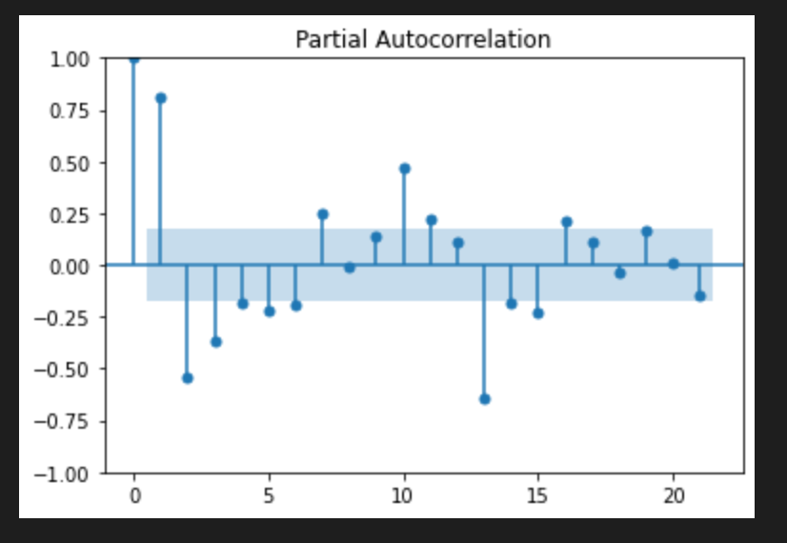
Last week, I worked on running a acf and pacf model in python and it showed me that some of the lags I wanted to look at were 1, 2, 3, 10, and 13.

Slide 3
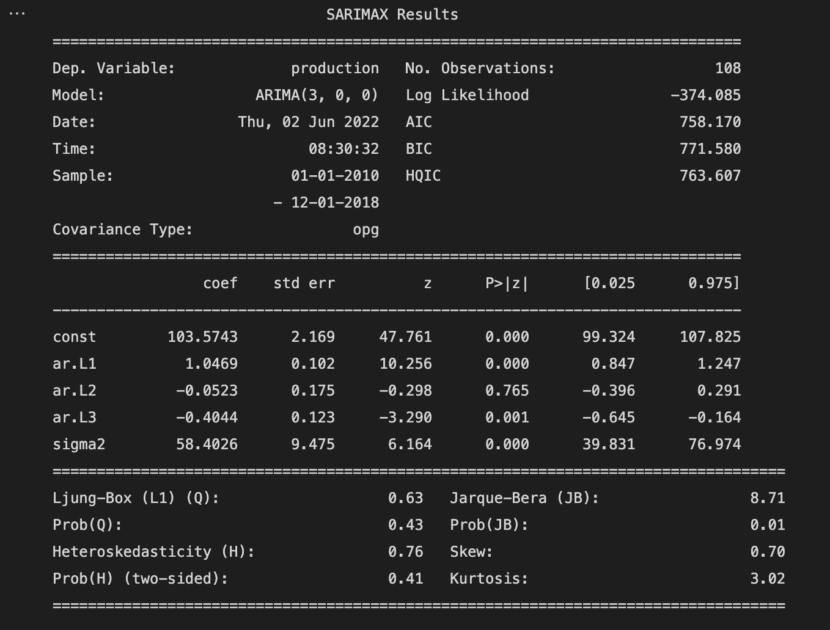
Here, I ran some analysis on the ice cream production data that focused on the lags 1-3. Something to note is the p value, which can tell us what data is statistically significant by which p<0.05. So lags 1 and 3 are significant and lag 2 is not significant.

Slide 4
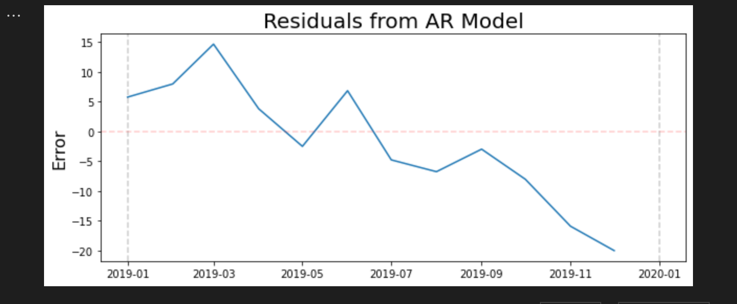
Next I wanted to look at the residuals for the data, which is how far a point is from the regression line.

Slide 5
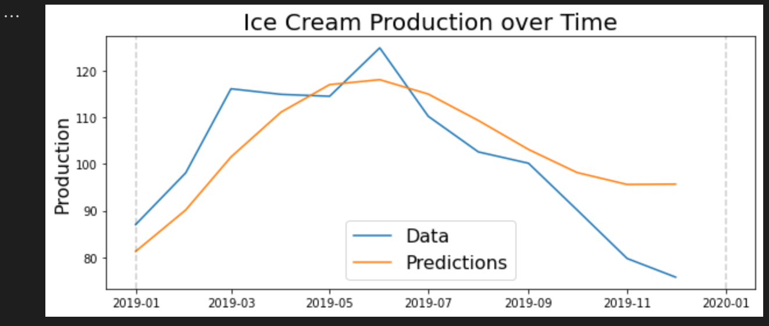
Then I graphed the prediction data over the actual data. Something I learned the first week was that the margin of error increases the further into the future it is trying to predict. Here i can see that towards the end, it began to trail off the data a lot more.

